Slide 1
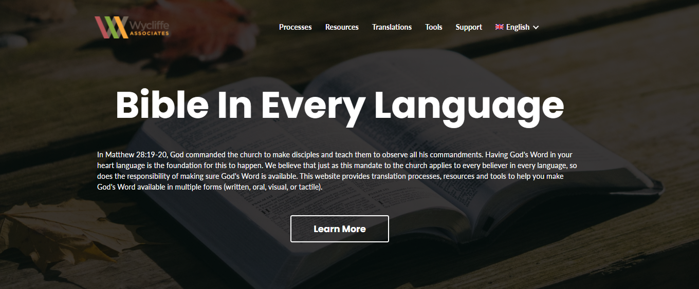
Accessing the
English Resources
Notes:
Would you be able to make a PPT to show how to download the PDFs of the ULB and Notes/questions/words from BIEL? And would you also be able to make one that shows how to find the RG and choose which format and how to download it?

Slide 2
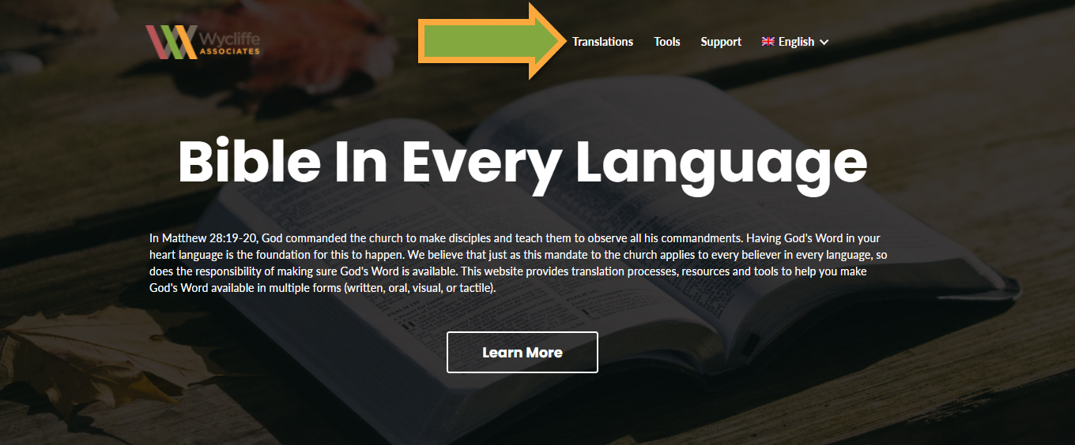
Go to the Translations Page
Click on the ‘Translations’ link located in the top menu bar.

Slide 3
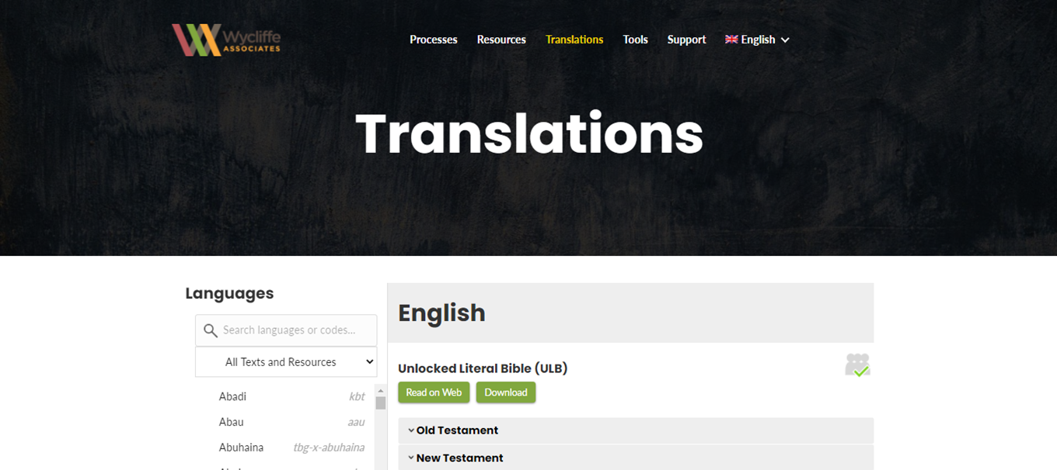
The Translations Page opens to English

Slide 4
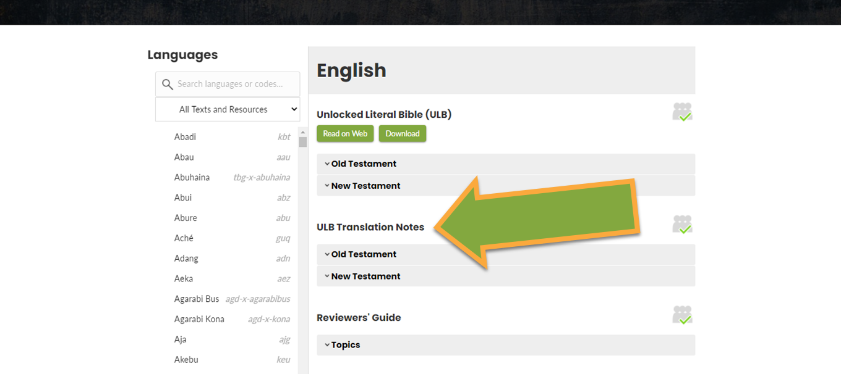
Scroll down to the ULB Translation Notes section.

Slide 5
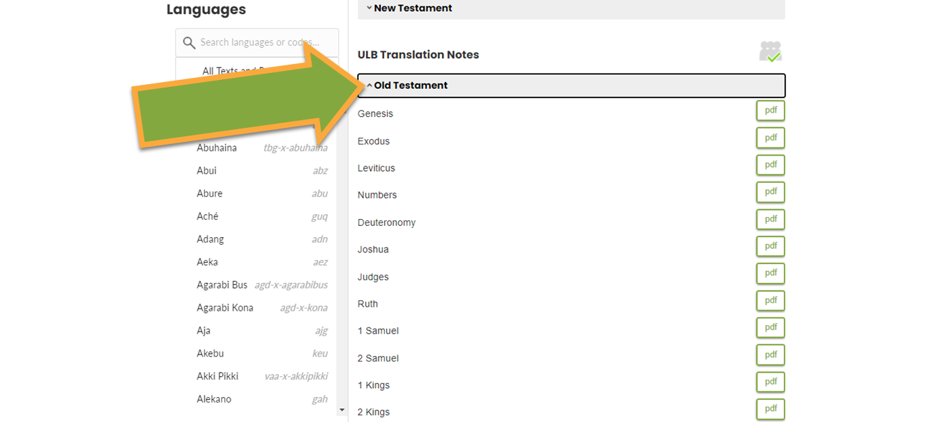
Click to open the Old Testament or New Testament book list.

Slide 6
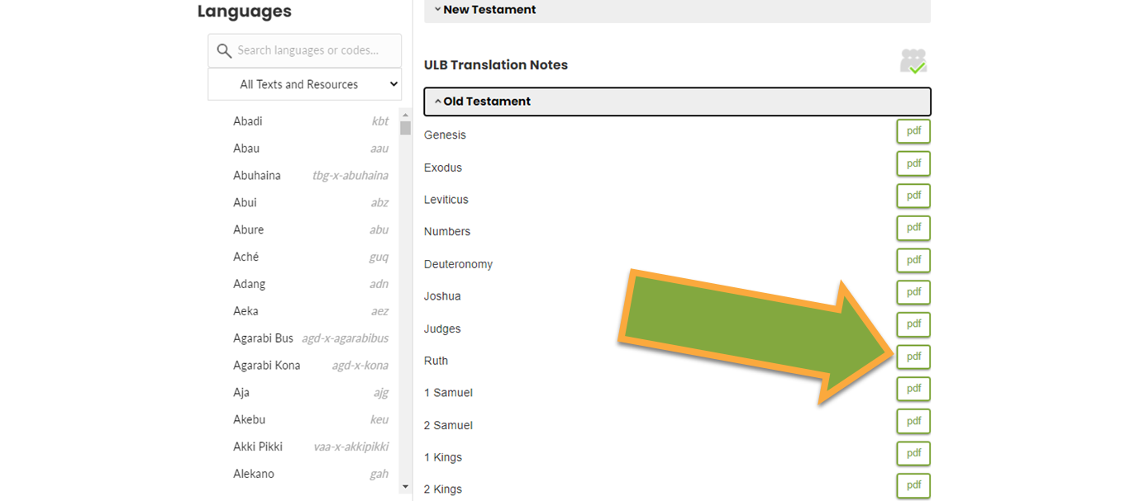
Click the pdf button to open a book file.

Slide 7
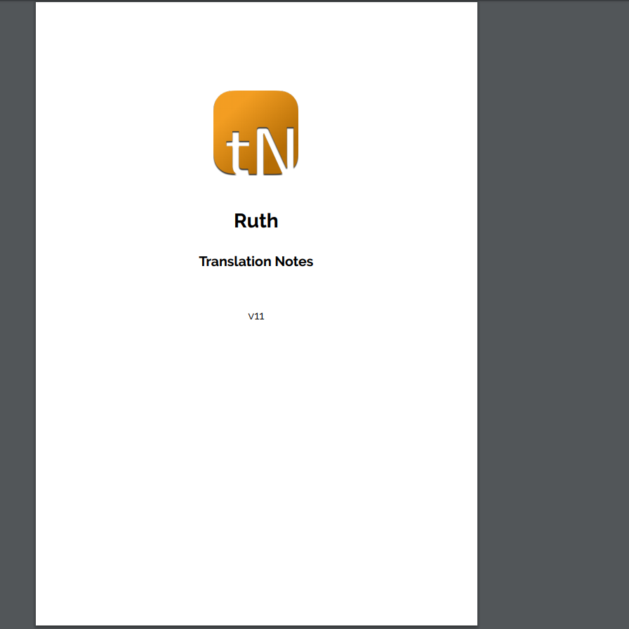
The PDF of the Translation Resources opens.

Slide 8
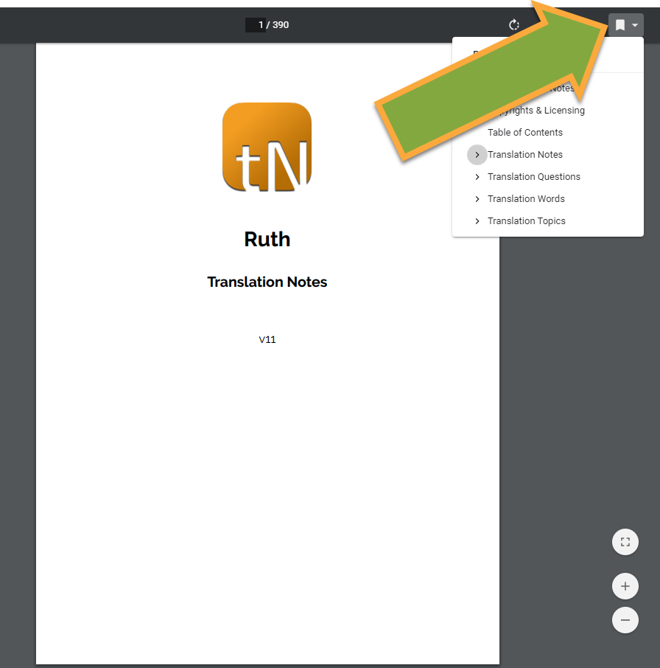
Click on Bookmark icon to open bookmark menu.

Slide 9
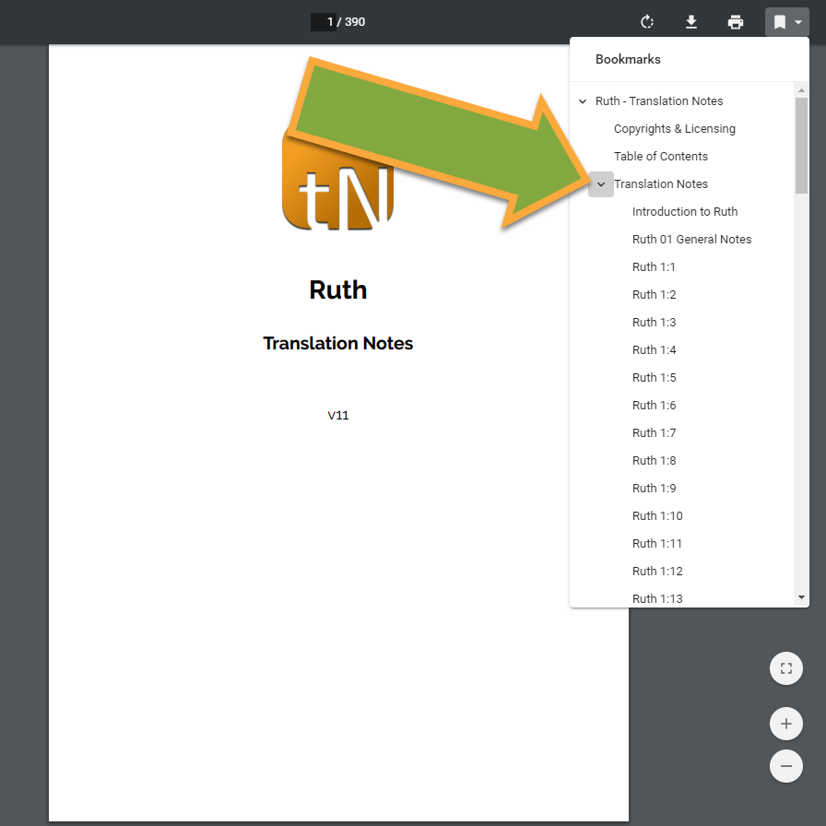
Click the down arrow icon to open the Translation Notes menu.

Slide 10
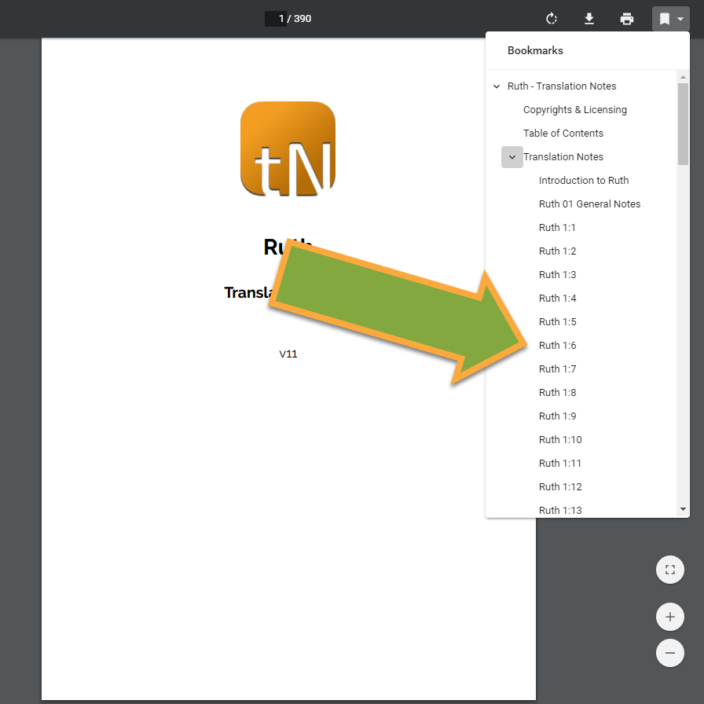
Click to choose a chapter and verse. The page opens.

Slide 11
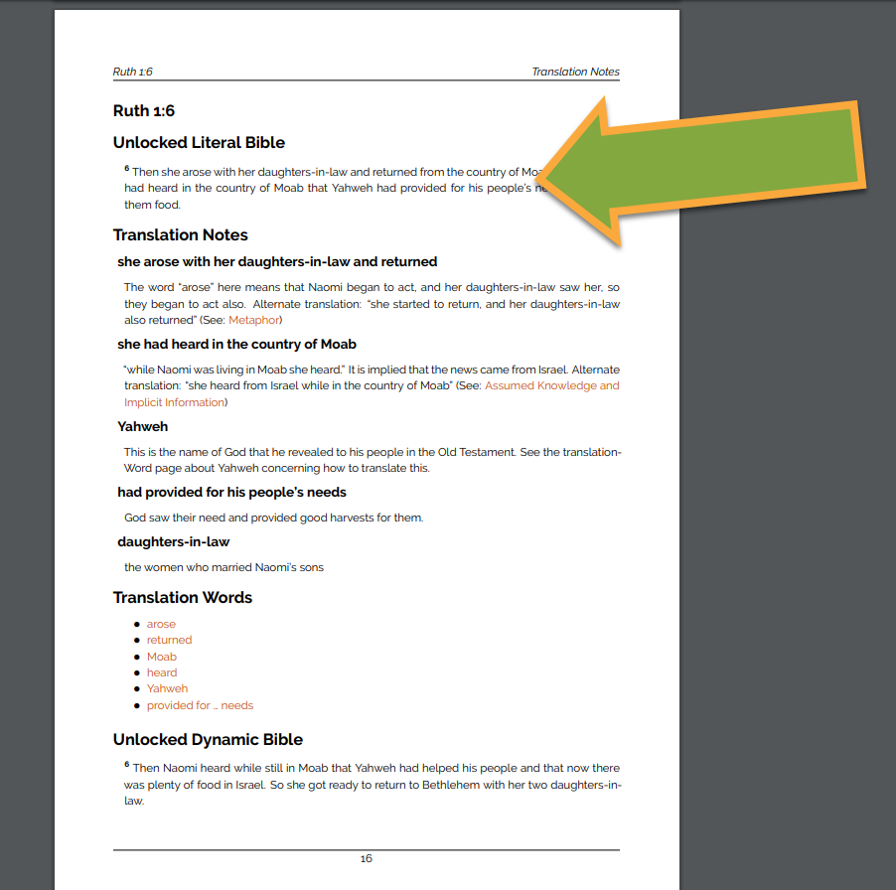
The ULB version of the verse is at the top of the page.

Slide 12
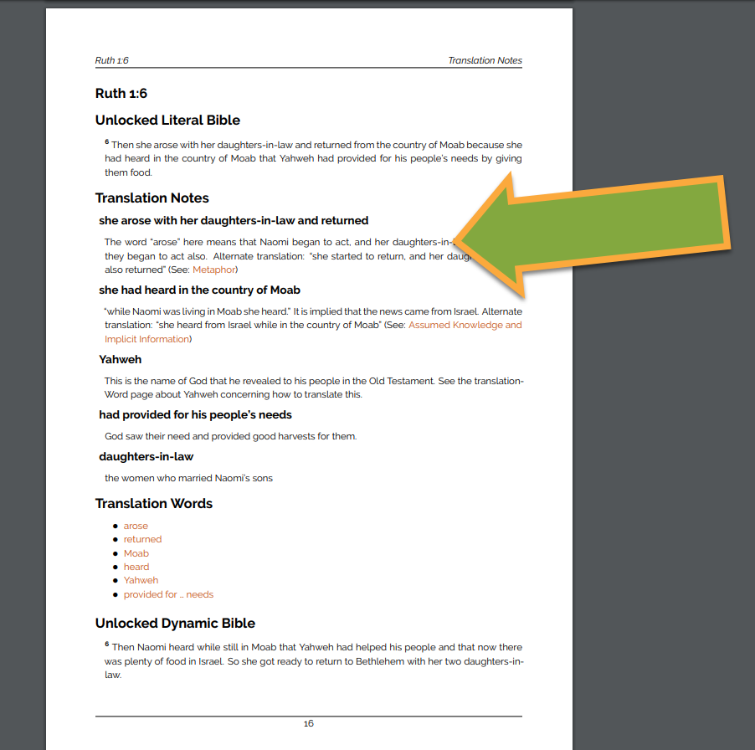
The Translation Notes for the verse are just below the verse. There may be more than one.

Slide 13
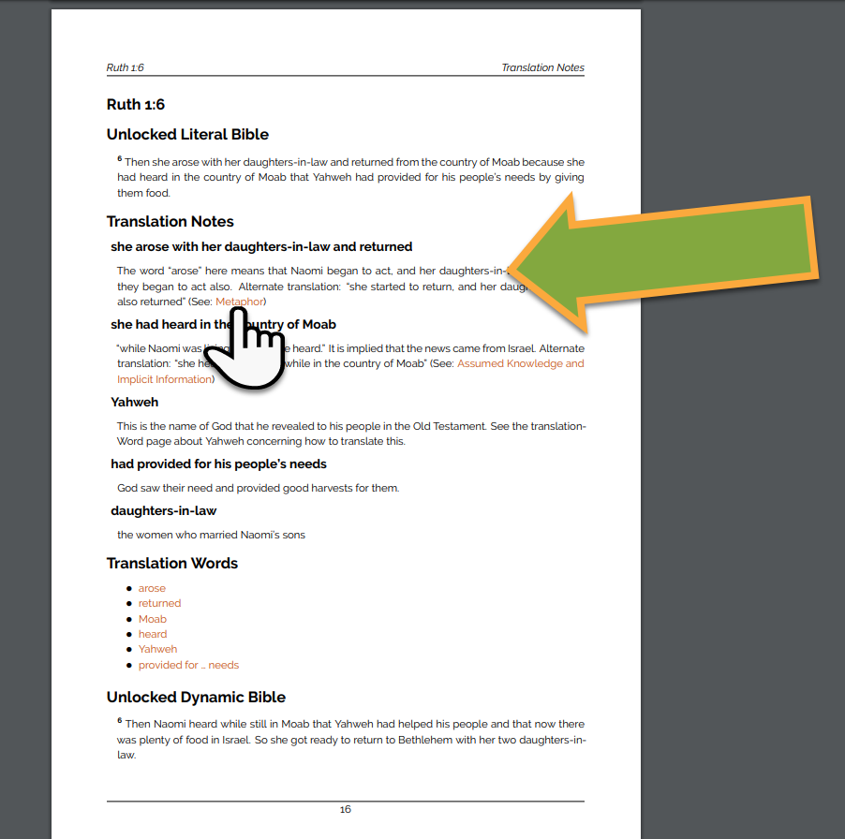
Sometimes there are links to Translation Topics. Click on a link to learn more.

Slide 14
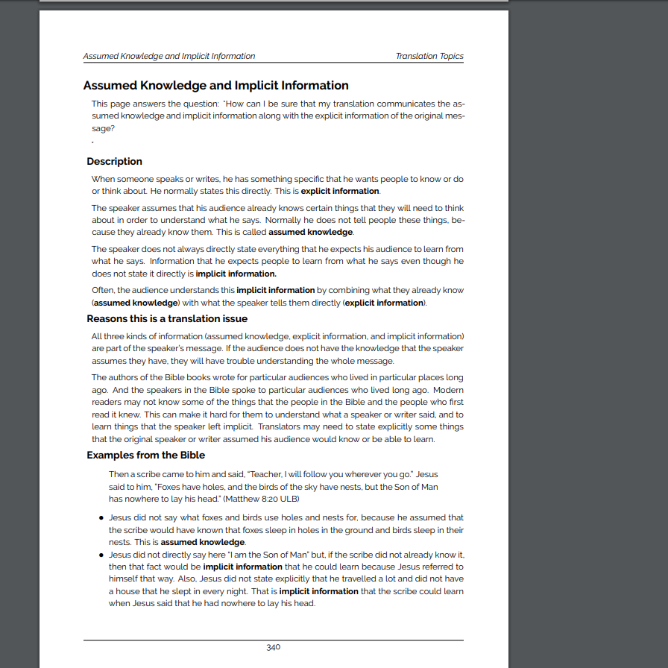
The Translation Topic gives more information about difficult translation situations.

Slide 15
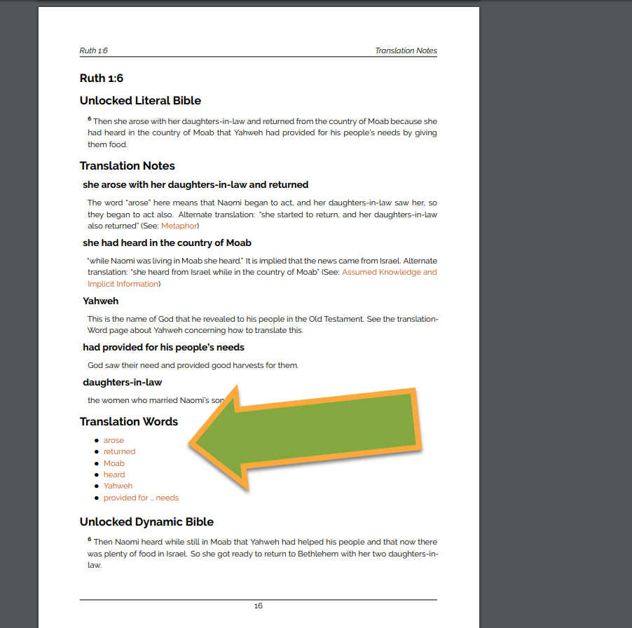
The Translation Words for the verse are under the Translation Notes. These are important words.

Slide 16
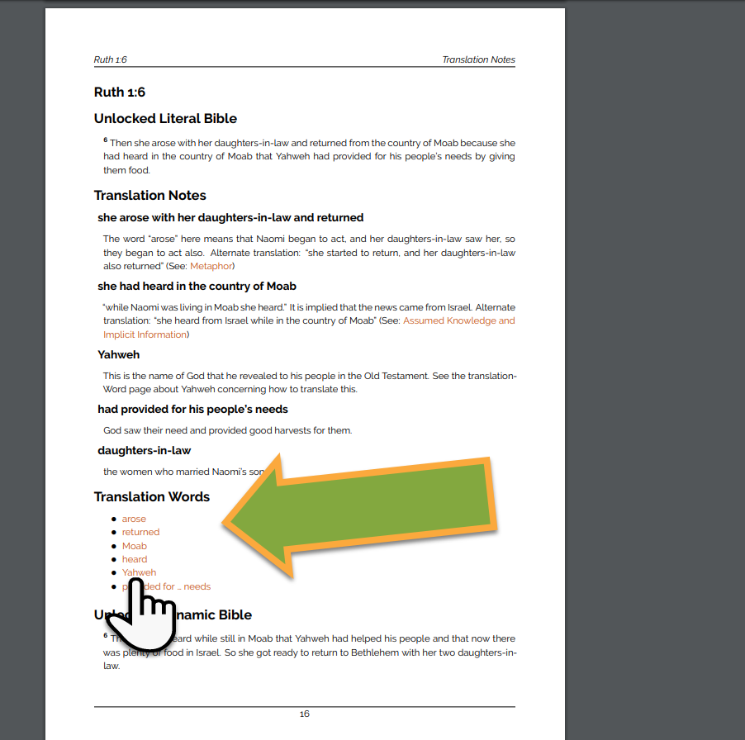
Click on the word to open the page with more information about the important word.

Slide 17
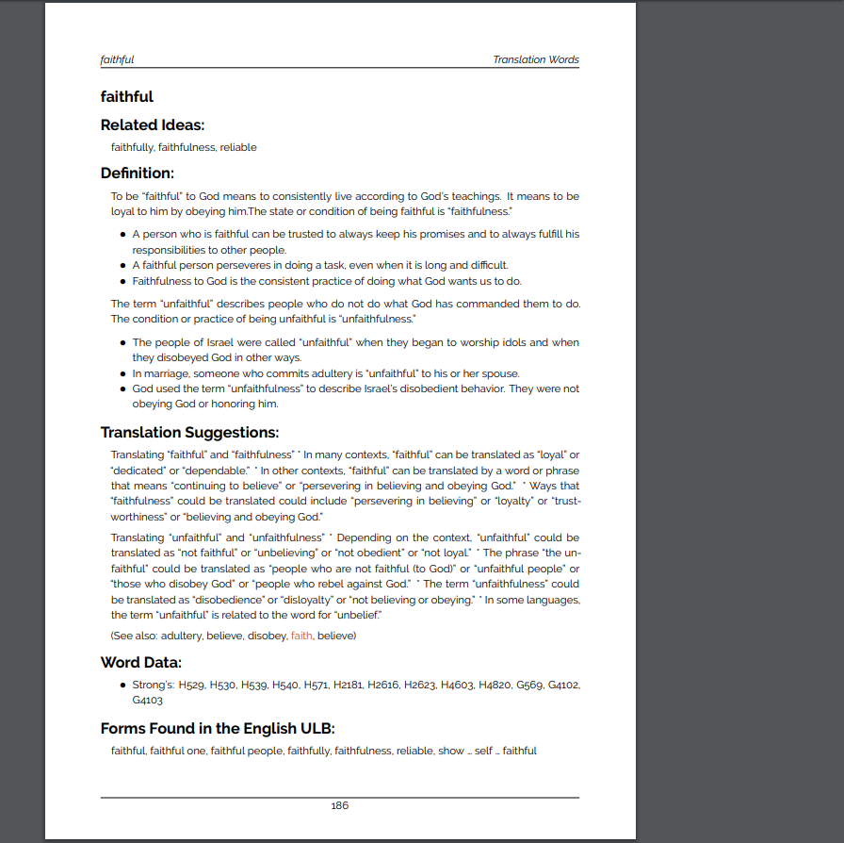
The Translation Words page has definitions and helps for translators.

Slide 18
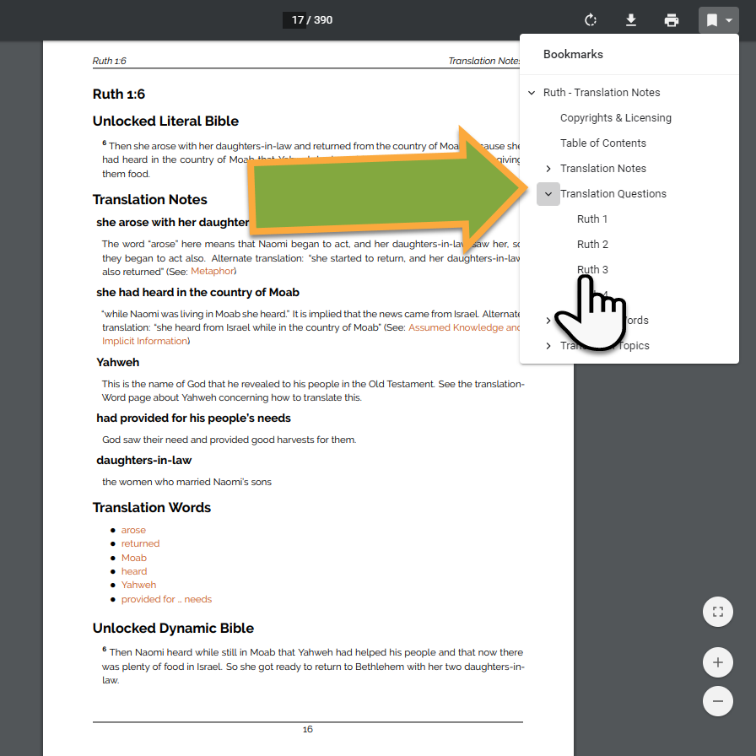
Use the Bookmark to find the Translation Questions. Click on the chapter to open.

Slide 19
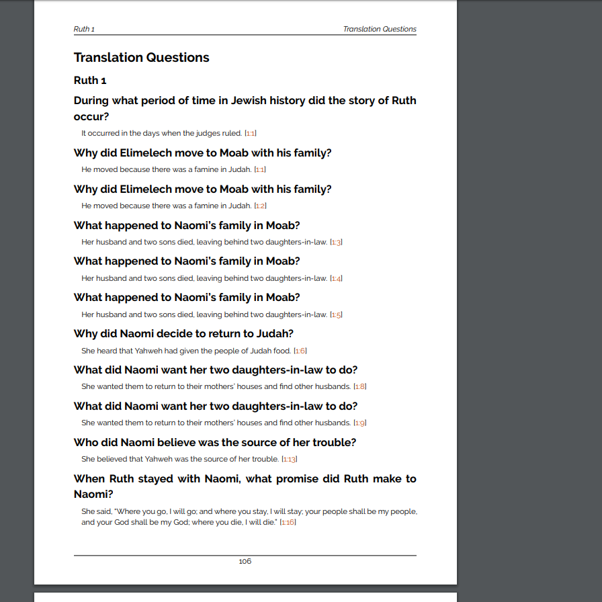
Use the questions with the language community to check the translation work.

Slide 20
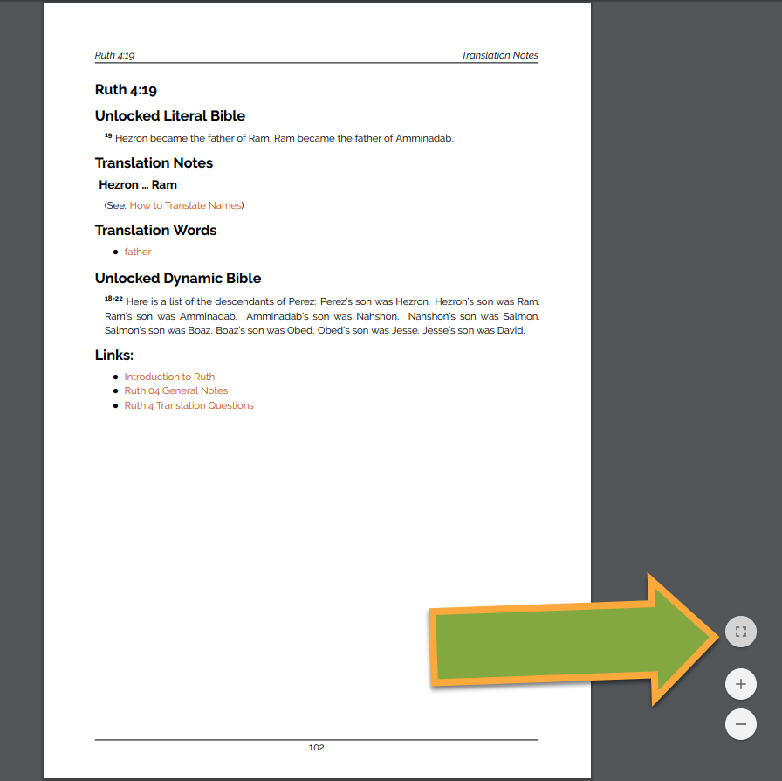
Navigate Click the top circle for a full-page view.

Slide 21
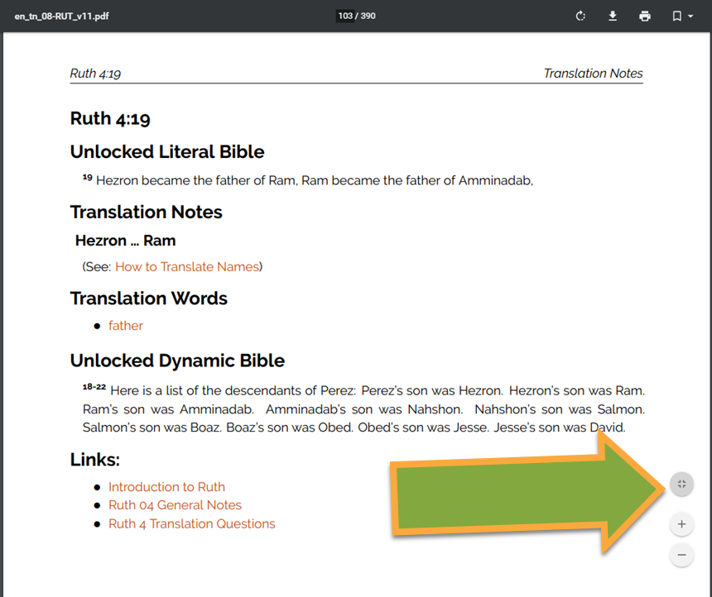
Navigate Click the top circle again for a page width view.

Slide 22
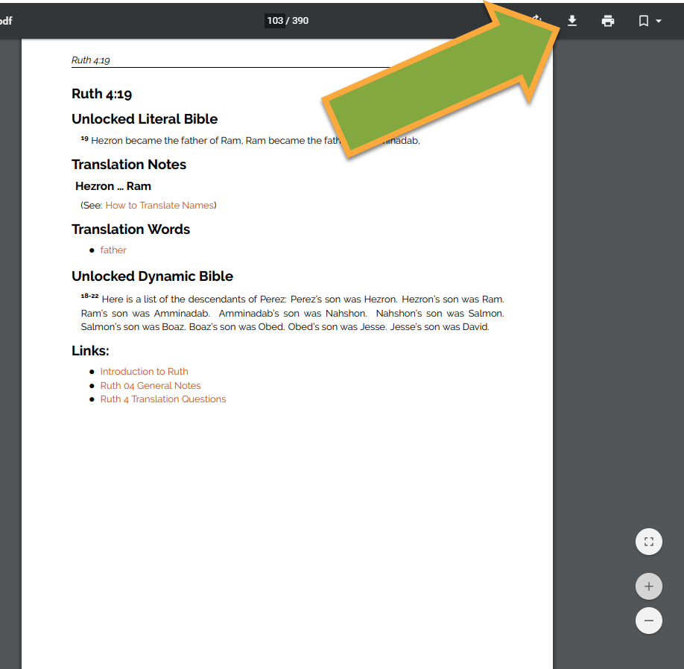
Navigate Click the download icon to save the document to your computer.

Slide 23
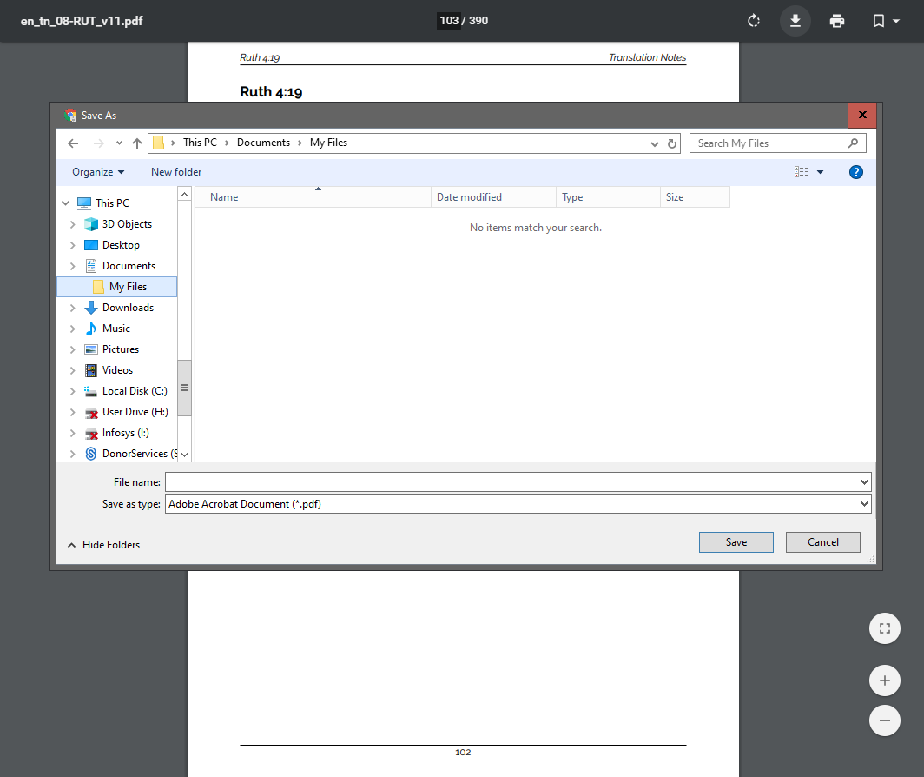
Navigate Save the document to your computer.

Slide 24


